Slide 1

3 Tablets

Slide 2

Three major causes for illness
UNSCIENTIFIC, UNWANTED, IRREGULAR EATING
UNSCIENTIFIC,UNWANTED, IRREGULAR THOUGHTS
UNSCIENTIFIC, UNWANTED, IRREGULAR RELATIONSHIPS

Slide 3

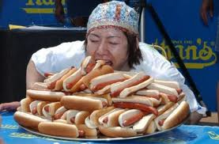
UNSCIENTIFIC UNWANTED IRREGULAR EATING

Slide 4

UNSCIENTIFIC UNWANTED IRREGULAR EATING
VEGETARIANISM
ONLY FOR APPETITE
ONLY FOR TASTE

Slide 5

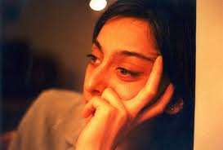
UNSCIENTIFIC, UNWANTED IRREGULAR THINKING

Slide 6

UNSCIENTIFIC, UNWANTED IRREGULAR THOUGHTS
MEDITATION
MIND CALMNESS
POSITIVE THINKING, MIRACULOUS THINKING
PURPOSEFUL THOUGHTS

Slide 7


UNSCIENTIFIC,UNWANTED,IRREGULAR RELATIONSHIPS

Slide 8
UNSCIENTIFIC,UNWANTED,IRREGULAR RELATIONSHIPS
PURPOSEFUL RELATIONSHIPS
LIFE TIME CHOICE
LIKE ATTRACTS LIKE
DURING TRAVEL

Slide 9

Three master key’s
Meditation
Swadhyaya yoga (Reading spiritual books)
Sharing of experiences

Slide 10

Meditation
Anapanasati Meditation
Observing natural breath
Minutes = Age
Any time & place is ok…

Slide 11

SWADHYAYA YOGA

Slide 12


SWADHYAYA YOGA
SPIRITUAL BOOKS READING
LIFETIME ESSENCE

Slide 13
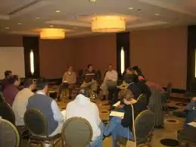
SHARING OF EXPERIENCES

Slide 14
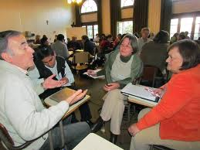
- Sir Franscis Bacon!
“ Conference makes for a ready man ” !
“ People are known by the company they keep”.

Slide 15



SHARING OF EXPERIENCES
LIKE ATRACKS LIKE
What we teach that we learn most !
We are all learners, teachers and doers !
- Richard Bach

Slide 16
THREE MAJOR QUALITIES
HARD WORK
INTELLECT
PHILOSOPHY

Slide 17
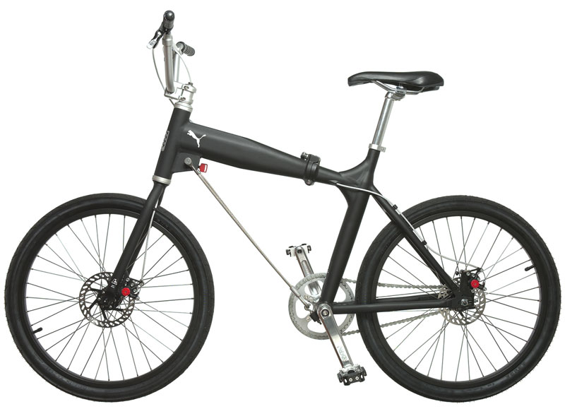
HARDWORK

Slide 18

HARDWORK
AT EVERY STAGE
CYCLE
QUANTITY

Slide 19


INTELLECT

Slide 20
INTELLECT
“ INTELLECT ” - TECHNOLOGY, LANGUAGE BARRIERS Etc
QUALITY
Sub ordinate management ( Hard work / repetitions)

Slide 21

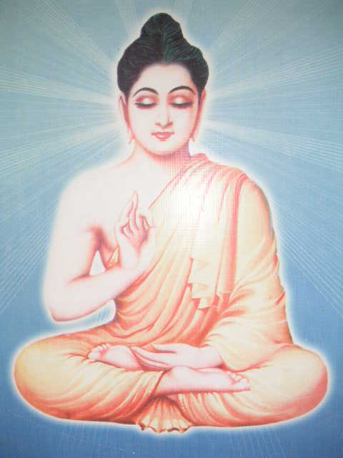
PHILOSOPHY

Slide 22
PHILOSOPHY
METAPHYSICAL DRIVE
FINE TUNING / THINGS
MIRACULOUS THINKING
SHEER COMMENSENSE

Slide 23

STAGES OF LEARNING
LABOUR
ACCOUNTANT
OFFICER

Slide 24
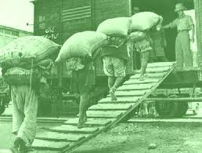
LABOUR
DAY TO DAY
NO SAVINGS
NO CHEQUE POWER
TOTALLY DEPENDENT

Slide 25

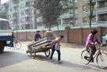
LABOUR
LEARNING IN GENERAL
LIKES AND DISLIKES – PRESENT
NO BOUNDING (ABOVE AND BELOW)
PERFECTION - 60%

Slide 26

ACCOUNTANT
EVERY PIE COUNTS
PROFIT AND LOSS IMMETERIAL
PARTIAL CHEQUE POWER

Slide 27

ACCOUNTANT
EVERY ACTION COUNTS
NO LIKES AND DISLIKES
NO SUCCESS AND FAILURE
STRICTLY FOLLOW GUIDENCE (ALL)
PERFECTION – 60% - 80%

Slide 28

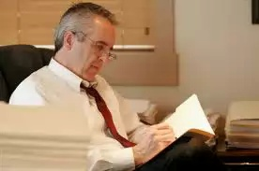
OFFICER
TOP MOST
DISASTER MANAGEMENT
FULL CHEQUE POWER

Slide 29
OFFICER
COMPLETE
NO DEPENDENCY
RESPONSIBLE
TERMINAL LESSONS
DECISION MAKER

Slide 30

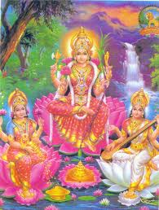
PHASES OF LIFE
GODDESS OF MONEY (LAKSHMI)
GODDESS OF SPIRITUALITY (PARVATHI)
GODDESS OF ARTS (SARASWATHI)

Slide 31

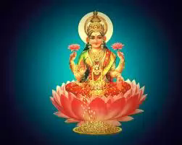
GODESS OF MONEY ( LAKSHMI )

Slide 32
GODDESS OF MONEY (LAKSHMI) :
MONEY
BASED ON MONEY
(DHANAM MULAM IDAM JAGAT)
MATERIAL HAPPINESS

Slide 33

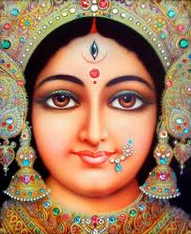
GODDESS OF SPIRITUALITY (Parvathi)

Slide 34

GODDESS OF SPIRITUALITY (PARVATHI) :
SPIRITUAL KNOWLEDGE
MEDITATION, SPIRITUAL BOOK READING & SHARING
WHO AM I & PURPOSE OF LIFE

Slide 35
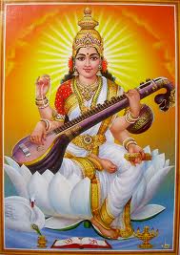
GODDESS OF ARTS (SARASWATHI)

Slide 36
SARASWATHI
Artha - Money & Arts
Music , dance & instrumental
All arts (Every one, every art)
Ceni-field dreams
Feel / instrumental exp.,

Slide 37

THREE DUTIES (DHARMAS)
DUTIES OF PHYSICAL BODY (SHAREERA DHARM)
DUTIES OF FAMILY / COMMUNITY (KUTUMBA DHARM)
DUTIES OF THE SOUL (SWADHARM)

Slide 38

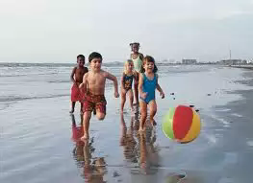
DUTIES OF PHYSICAL BODY (SHAREERA DHARM)

Slide 39

DUTIES OF PHYSICAL BODY (SHAREERA DHARMA)
PLEASURE THROUGH ALL PHYSICAL SENSES

Slide 40
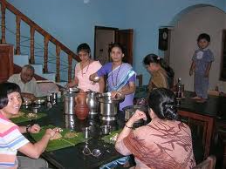
DUTIES OF FAMILY / COMMUNITY (KUTUMBA DHARMA)

Slide 41
DUTIES OF FAMILY / COMMUNITY
(KUTUMBA DHARMA)
BLOOD RELATIONS
SPIRITUAL FAMILY

Slide 42
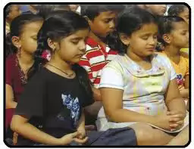
SWADHARMA

Slide 43
SWADHARMA
DIVINE EXPERIENCES
SOUL EXPERIENCES BEYOND SENSES
SELF REALIZATION

Slide 44

PLACE IMPORTANCE
VILLAGE
CITY
TRAVELLER

Slide 45
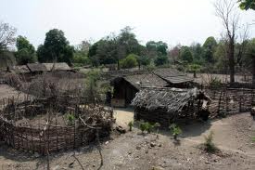
VILLAGE

Slide 46
VILLAGE
STATIC QUALITIES
LIVING WITH NATURE
DEVELOPMENT AS A GROUP

Slide 47
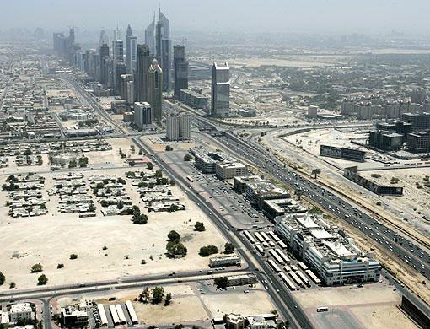
CITY

Slide 48
CITY
DYNAMIC QUALITIES
INTELLECTUAL DEVELOPMENT
INDIVIDUAL DEVELOPMENT

Slide 49
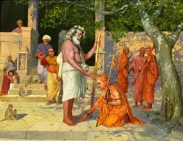
TRAVELLER

Slide 50
TRAVELLER
SHIFTING JOB
FLEXBILITY

Slide 51

Dr P.S.Gopala Krishna M.B.B.S
Founder : Pyramid Spiritual Health care
Contact : 09246648410, 09051334949
Email id : spiritualhealthcare2012@gmail.com
For Appointments ,counseling's
and Training workshops
Contact :
North – 09769707371 South - 9246648411

Slide 52

SOUL FAMILY - APPROUCHES
PYRAMID SPIRITUAL SOCIETY MOVEMENT (PSSM)
ENJOYMENT SCIENCE ACADEMY (ESA)
PYRAMID PARTY OF INDIA (PPI)
(ADMINISTRATIVE POURPOSE)

Slide 53
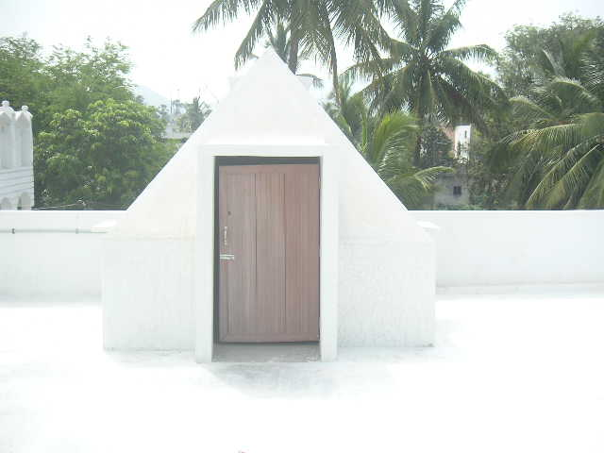
PYRAMID SPIRITUAL SOCIETY MOVEMENT (PSSM)
PYRAMID SPIRITUAL SOCIETY

Slide 54
PYRAMID SPIRITUAL SOCIETY MOVEMENT(PSSM)
SPREADING THROUGH SPIRITUAL TEACHING
SPIRITUAL SCIENTIST

Slide 55
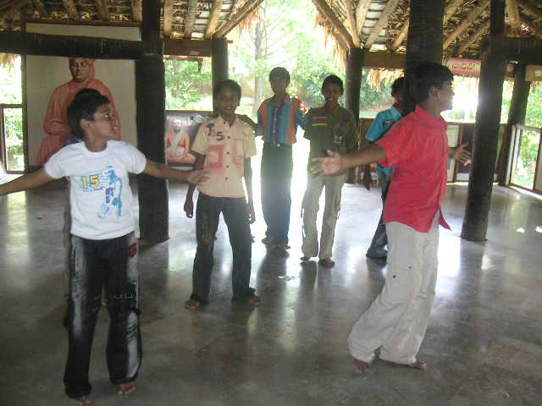
ENJOYMENT SCIENCE ACADEMY (ESA)

Slide 56
ENJOYMENT SCIENCE ACADEMY
SPREADING THROUGH CULTURAL MEANS
MUSICAL INSTRUMENTS & ARTISTS.

Slide 57
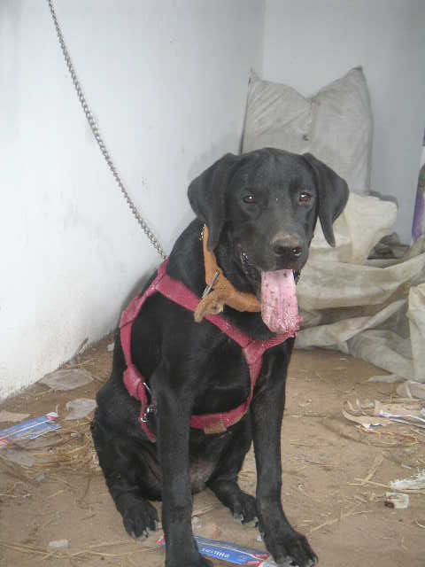
PPI
PYRAMID PARTY OF INDIA
ADMINISTRATIV JOB
PHILOSOPHERS ARE RULARS

Slide 58
PPI
ADMINISTRATIVE JOB
DOG, BUS

Slide 59

THREE KINDS OF SERVICES
SOCIAL SERVICE
SPIRITUAL SERVICE
SPIRITUAL SCIENCE SERVICE

Slide 60
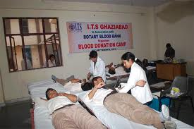
SOCIAL SERVICE

Slide 61
SOCIAL SERVICE
FOOD, CLOTHING AND SHELTER SERVICES
TEMPORARY

Slide 62
SPIRITUAL SERVICE
MONITORY SERVICES KEEPING ENLIGHTEND MASTER’S PHOTO
DIFFERENT MISSIONS / SPIRITUAL ORGANISATIONS

Slide 63
SPIRITUAL SERVICE
TOTAL SERRENDERENCE (SARANAGATI)
POSITIVE ATTITUDE
BETTER THAN SOCIAL SERVICE

Slide 64
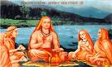
SPIRITUAL SCIENCE SERVICE

Slide 65
SPIRITUAL SCIENCE SERVICE
TEACHING SPIRITUAL SCIENCE
SHARING OF EXPERIENCES

Slide 66

THREE STAGES
PATIENT (ROGI)
PLEASURE (BHOGI)
SAINT (YOGI)

Slide 67
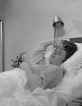
PATIENT (ROGI) (SLEEP, FOOD)

Slide 68
PATIENT (ROGI) (SLEEP, FOOD)
3 TIMES FOOD PER DAY
AWAKE - FULL NIGHT

Slide 69
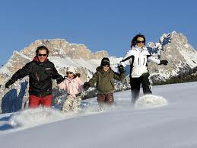
PLEASURE (BHOGI)

Slide 70
PLEASURE (BHOGI)
TWO TIMES FOOD PER DAY
AWAKE - FULL NIGHT

Slide 71
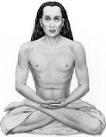
SAINT (YOGI)

Slide 72
SAINT (YOGI)
ONCE IN A DAY - FOOD
AWAKE - FULL NIGHT

Slide 73

THREE DIFFICULTIES
DIFFICULTIES DUE TO LACK OF SPIRITUALITY
(ADYATMIKA TAPAM)
DIFFICULTIES DUE TO PHYSICAL EXSISTANCE
(ADI BHOWTIKA TAPAM)
COSMIC DIFFICULTIES
(ADI DAIVIKA TAPAM)

Slide 74
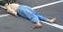
ADHYATMIKA TAPAM

Slide 75
ADHYATMIKA TAPAM
90%
Lack of spiritual knowledge
Death, third eye, levels of souls etc.,

Slide 76
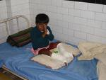
ADHIBHOWTIKA TAPAM

Slide 77
ADHIBHOWTIKA TAPAM
10% PHYSICALBODY GAME – EARTH
STAGNATION – REFLECT ON BODY

Slide 78
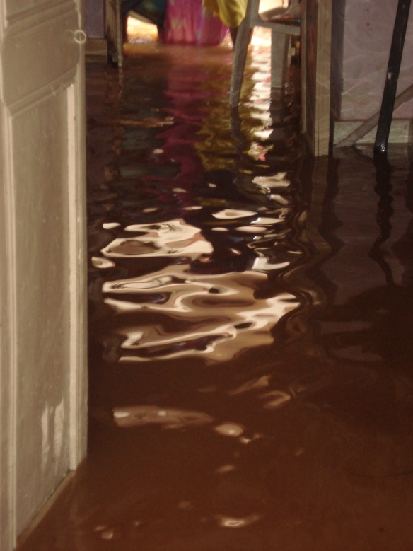
ADI DAIVIKA TAPAM

Slide 79
ADI DAIVIKA TAPAM
1% NATURAL CALAMITY
RIGHT PLACE - GOD

Slide 80

THREE STATES
PAST - I
PRESENT - I
FUTURE - I

Slide 81
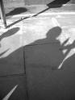
PAST I

Slide 82
PAST I
Madhuranubhooti
Unpleasant past
Never prolong / cut
Community level purpose – needs past life checking

Slide 83

PRESENT I

Slide 84
PRESENT I
On job
Living in the moment
Self contentment

Slide 85
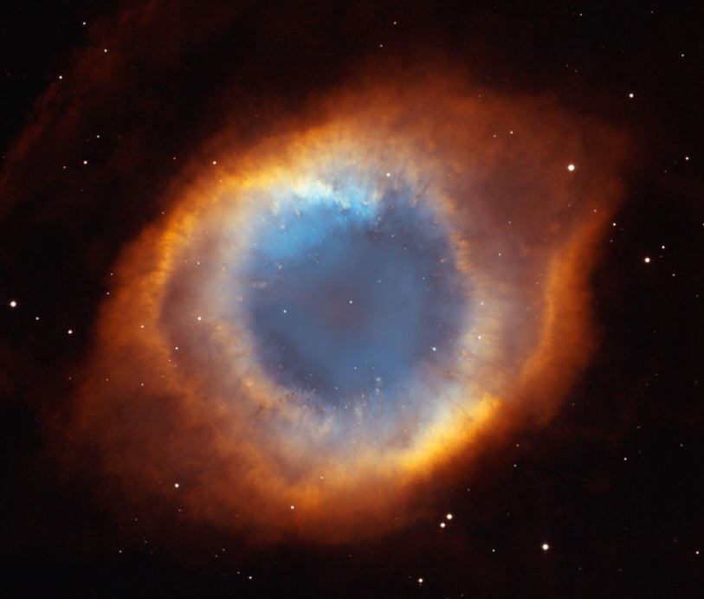
FUTURE I

Slide 86
FUTURE I
Planning (material and spiritual)
Creative visualization
Daily, weekly, yearly, schedule – based on spiritual experiences

Slide 87

MEALS
RICE
CURRY
SWEET

Slide 88
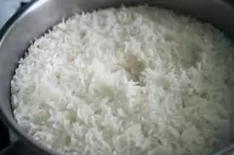
RICE

Slide 89
RICE / ROTI / BREAD
PRIMARY UNDER STANDING
I AM SOUL, NOT THE BODY
COMMON FOR EVERYONE

Slide 90
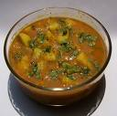
CURRY

Slide 91
CURRY
VARIES – PERSON TO PERSON
PURPOSE OF LIFE
UNIQUE

Slide 92
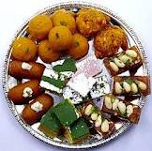
SWEETS

Slide 93
SWEET
10 OUT OF 10
ULTIMATE - FINE PERFECTION
“SWEETNESS - MADHURY”

Slide 94

COMMUNITY GOD
GRUHA DHARMAM
PRACHARA DHARMAM
ASHRAMA DHARMAM

Slide 95

GRUHA DHARMAM

Slide 96
GRUHA DHARMAM
Material pleasures
Material Services

Slide 97
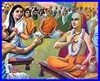
PRACHARA DHARMAM

Slide 98
PRACHARA DHARMAM
Spreading truth
Tatvamasi
Oneness god

Slide 99
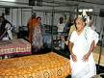
ASHRAM DHARMAM

Slide 100
ASHRAMA DHARMAM
Spiritual lessons
Sadhana – intensive
Very less material pressures

Slide 101

LEVELS OF SOCIETY
LOWER CLASSS (ADHAM)
MIDDLE CLASS (MADYAM)
UPPER CLASS (UTTAM)

Slide 102
LOWER CLASSS (ADHAM)
DAY TO DAY SELF NEEDS
VOCCATIONAL COURSES
SELFFISH AND DEPENDENT

Slide 103
MIDDLE CLASS (MADYAM)
PROTECTOR – SOCIAL
PARTIAL SACRIFICE

Slide 104
UPPER CLASS (UTTAM)
SPIRITUAL RULER
COMPLETE SACRIFICE

Slide 105

THREE STATES
YANTRA
MANTRA
TANTRA

Slide 106
YANTRA
PHYSICAL VEHICAL
FUEL – VEGETARIAN DIET
SENCES HAPPINESS & TAKEING CARE

Slide 107
MANTRA
RIGHT SPEECH
SILENCE
VISUDDA
THYRIOD COMPLAINTS

Slide 108
TANTRA
METAPHYSICAL
THIRD EYE EXPIRENCES Etc

Slide 109

THREE KINDS HAPPINESSES
VISHAYANANDAM
BHAJANANANDAM
BRAMHANANDAM

Slide 110
VISHAYANANDAM
IDLI , COFFEE - HAPINESS
ALL PHYSICAL PLEASURES

Slide 111
BHAJANANANDAM
MUSIC / DANCE
ALL ARTS

Slide 112
BRHAMANANDAM
SOUL LEVEL, DIVINE EXPIRENCES
MEDITATION EXPIRENCES Etc.,
SAMADI STATE (BLISSFUL STATE)

Slide 113

STAGES OF THIRD EYE DEVELOPMENT
THIRD EYE OPENING
THIRD EYE PERFECTION
THIRD EYE COMPLETION

